Slide 1
Introducing IBIS
Michael Mirmak
Chair, IBIS Open Forum
IEEE DASC Meeting
October 6, 2011

Slide 2
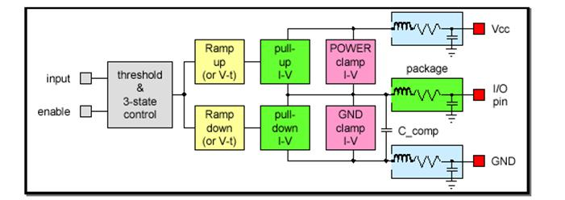
IBIS: Both Standard & Organization
IBIS – I/O Buffer Information Specification, Ver. 5.0
  ASCII data format for silicon I/O signal integrity modeling
  Standardized as ANSI/EIA* 656-B (4.2), IEC* 62014 (3.2)
  Managed by the IBIS Open Forum (IBIS Committee)
  Analog base: resistance, transition speed, capacitance
Extended in recent years
  AMS: Verilog-A, Verilog-AMS, VHDL-AMS support
  AMI: Algorithmic Modeling Interface for advanced SerDes

Slide 3
Specifications and Technologies
IBISCHK5: Free IBIS Syntax Checker and Parser
  http://www.eda.org/ibis/ibischk5/
  Source code available under license for a fee
IBIS Quality Specification
  Defines a structured rating system for IBIS models
Touchstone 2.0
  Network parameter descriptions (e.g., S-parameters)
  TSCHK2 parser also offered
Other specifications and documents
  ICM and IBIS-ISS (WIP) for interconnect descriptions

Slide 4
IBIS Open Forum
Began in 1993, managing specifications & parsers
Now a committee under TechAmerica
  ANSI standardization through TechAmerica accreditation
  IBIS follows TechAmerica (ANSI) legal & operational rules
Entity-based, averaging 30 members annually
  Meets every three weeks via teleconference
  Members vote on specifications & document changes
Holds multiple free Summits annually worldwide
  DAC, DesignCon in the US plus European and Asian events
  Strong and continuing relationship with JEITA
IBIS seeks greater interaction with DASC and
a streamlined path to IEC standardization

Slide 5
Backup

Slide 6
IBIS Board
Is final approver of specification ballots
Appoints Task Groups and ad-hoc officials (e.g., treasurer)
Manages meetings
Chair
Vice-Chair
Manages meetings and summits in Chair’s absence
Usually acts as summit registration contact
Secretary
Tracks balloting, membership and standards relations
Responsible for meeting and summit minutes
Model Librarian
Maintains on-line model reference library
Webmaster
Responsible for all web content
Primary focus on events, specifications, roster and tools
Non-
Charter
Officers
Postmaster
Responsible for IBIS reflectors (IBIS, IBIS-Users)
Usually “first responder” to non-list participant questions

Slide 7
IBIS Task Groups
IBIS Committee
(“IBIS Open Forum”)
Task Groups
Editorial
Michael Mirmak, Intel
Advanced Technology
Modeling Group
Arpad Muranyi,
Mentor Graphics
Model Review
Lynne Green,
Green Streak Programs
Quality
Mike LaBonte, Indep.
Notes
The Interconnect Task Group has been suspended pending
EDA vendors comprise Model Review, independently reviewing received models and providing feedback to model authors; no specification changes are recommended by this group and it does not hold meetings
Participation in the IBIS Task Groups is open to the general public
Task Groups are created and Chairs appointed by the IBIS Chair
Some issues are handled by Ad Hoc teams for BIRD development

Slide 8
How Changes Are Made
BIRDs: Buffer Issue Resolution Documents
  Change proposals for the IBIS specification
  Submitted by individuals or Task Groups
  If approved by IBIS Open Forum, included in future IBIS specification versions
BUGs: IBIS Parser issues
  Violations of the specification, unexpected behaviors or requests for improvement
  Usually submitted by individuals
TSIRDs: Touchstone Issue Resolution Documents
  Similar to BIRDs, but for Touchstone 2.0

Slide 9
References
IBIS Web site: www.eda.org/ibis/
  Links to Task Groups available there
Specifications
  IBIS 5.0: www.eda.org/ibis/ver5.0/
  Touchstone: www.eda.org/ibis/touchstone_ver2.0/
  ICM: www.eda.org/ibis/icm_ver1.1/
BIRDs
  www.eda.org/ibis/birds/
IBIS 4.0 Cookbook
  www.eda.org/ibis/cookbook/
Training
  www.eda.org/ibis/training/

