Slide 1
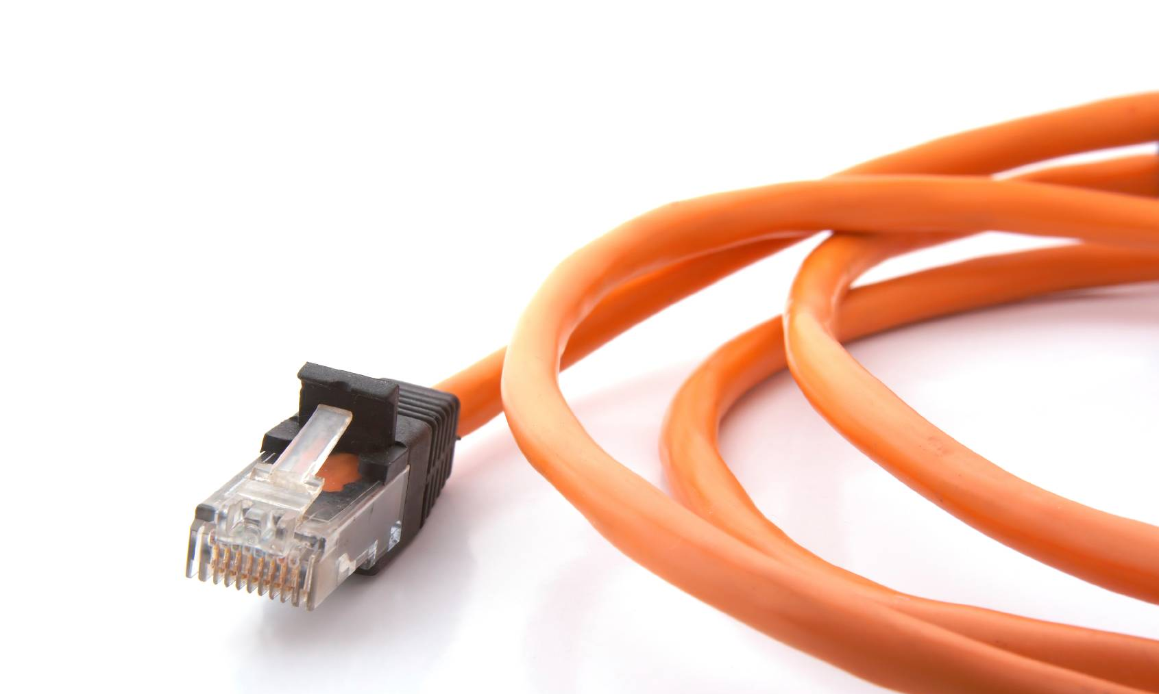
Elimination of:
- Reaffirmation & Stabilization (pg 2)
- Interpretations (pg 12)
Effective 1 January 2012

Slide 2
Replacement of
Reaffirmation and Stabilization

Slide 3
Replacement of Reaffirmation/Stabilization
The IEEE-SA BOG and SASB approved the replacement of the reaffirmation and stabilization processes in June 2011.
Changes will be reflected in the policies and procedures, effective 1 January 2012:
  SASB Bylaws
  SASB Operations Manual
Notes:
SASB Bylaw Clauses changes: 2.2, 4.2.3.1, 5.1, 5.2.5, 5.3, 6.2
SASB Ops Manual Clause Changes 1.2, 4.1.2, 5.4.1, 5.6.2.1, 5.7, 6.3.3, 8.1.2, 9, 9.1, 9.1.1, 9.1.2, 9.2, 9.3, 9.4

Slide 4
Rationale
The IEEE-SASB determined that it was important to:
  Have a process that permitted a standard to be revised when addressing comments during a reaffirmation so that IEEE standards will remain pertinent and of high technical value
  Streamline/simplify the maintenance process to ensure that participants would comply with the policies and procedures of both IEEE and ANSI
  Allow Sponsors and Working Groups additional time to review and complete a revision cycle
  Enable Sponsors to focus on revisions of standards that require maintenance action, rather than a diffusion of Sponsor efforts to meet administrative requirements for reaffirmation or stabilization

Slide 5
Rationale (continued)
Various options were considered and it was determined that the new process:
  Was simplest and least taxing on volunteer resources
  Allowed standards developers to concentrate on keeping IEEE standards relevant
  Reduced IEEE’s legal risk associated with outdated standards by making needed revisions where warranted by the Sponsor, Working Group, and Sponsor Balloting Group

Slide 6
Changes
Effective Jan 1, 2012
  There will be no new reaffirmation or stabilization ballots
  The only actions allowed by Sponsors will be:
    Revision
    Amendment/Corrigendum
    Withdrawal
  Standards will have a 10 year maintenance cycle (i.e., extended from 5 years to 10 years after the last date of approval or maintenance action)
  The status for a standard will be either active or inactive
  All standards must have a revision approved by the IEEE-SASB prior to the close of Year 10 in order to remain active
  Any standard not approved as a revision will become inactive after Year 10

Slide 7
Categories of Inactive Standards
inactive-superseded: These standards have been replaced with a revised version of the standard
inactive-reserved: These standards are removed from active status through an administrative process for standards that have not undergone a revision process within 10 years
inactive-withdrawn (valid for standards categorized after 1 January 2012): These standards have been removed from active status through a ballot where the standard is made inactive as a consensus decision of the balloting group
Notes:
inactive standards are still available for sale. Inactive-Reserved will become effective 31 December. It is until the submittal deadline for the December 2012 RevCom meeting.

Slide 8
Revisions
A revision ballot may result in:
  Changes to the standard
  Changes to only the references or bibliography
  No changes at all
In the event that no changes are made, the standard will retain its designation (i.e., the year will not change).
The title page will reflect the fact that a maintenance action occurred but no changes were made.
This will keep the standard active for another 10 years
Notes:
TPD Liaison should instruct Chair to update Sponsor Ballot Cover Letter to indicate.

Slide 9
Reaffirmation/Stabilization Transition Plan
Standards reaffirmed/stabilized prior to 1 Jan 2012 – use the latest of the following dates:
  By 31 December 2018 – 7 years after start of new program, or
  10 years from initial approval, or
  10 years from last maintenance action
Reaffirmation/Stabilization in invitation/ballot on 1 Jan 2012:
  1 year to complete (by 31 Dec 2012)
  If not completed by 31 Dec 2012, then item A applies
No new reaffirmation/stabilization invitations permitted after 31 Dec 2011

Slide 10
American National Standards
An ANS can be revised prior to Year 10 if deemed appropriate
Any IEEE standard that is currently an ANS will need to report to the administrator of the Standards Review Committee (RevCom) during Year 5 and explain whether a revision is in progress, or whether a revision is slated to be completed within the next 5 years

Slide 11
Input from Implementers of a Standard
Implementers can notify Sponsors or the IEEE if they believe a revision should occur prior to 10 years:
  In the front matter of each standard, implementers are notified that they can contact the Secretary of the IEEE-SASB to submit issues/concerns
  Implementers can contact the Sponsor directly online, or can contact a Staff Liaison who would be able to provide contact information or pass along the issues/concerns to Sponsors
  Sponsors can revise, amend or withdraw their standards at any time prior to Year 10
  An inaction on the Sponsor's part can be appealed to the IEEE-SA Standards Board where an appeal hearing can be performed
Notes:
Sponsors should be made aware that if they are in year 7 for an amendment project and don’t think they will complete the amendment by year 10, they should take out a revision PAR and roll up the amendment into it.

Slide 12
Elimination of Interpretations

Slide 13
Elimination of Interpretations
The IEEE-SA Standards Board approved a proposal to eliminate issuing interpretations in June 2011
Current practice: Interpretations should not constitute an alteration to the original standard
  At present, they are permitted to provide meaning to text that is ambiguous
13
Notes:
ProCom meeting June 14, 2011

Slide 14
Rationale
Inefficient and a risk
  Interpretation responses made in an attempt to clarify ambiguous text to be derived from a process that does not inform all materially interested parties of the activity
  Does not require consensus to be achieved through the Sponsor balloting process
14

Slide 15
Solution
More sensible to simply funnel comments on standards to Sponsors for handling
  Any document changes would appear in a revision amendment/corrigendum
  All require PARs – an open process & consensus through balloting
Therefore interpretations as discrete documents should be discontinued
15

Slide 16
Going Forward
Elimination of Interpretations
  In order to maintain ANSI accreditation, we are required to have an interpretations policy.
    Our interpretations policy can be that we do not supply Interpretations
Changes will be effective 1 January 2012
Changes to Ops Man, ByLaws, etc
  “The IEEE does not offer interpretations of its standards”
16

Slide 17
Questions?
Joan Woolery
j.woolery@ieee.org
  732-465-5893
17

