Slide 2
INTRODUCTION TO THE IEC
IEEE Computer Society (CS) Design Automation Standards Committee (DASC) Meeting
Dennis Brophy
Co-Convenor IEC TC 93 WG 2
ANSI USNC TAG

Slide 3
Contents
BRIEF REVIEW
DASC & IEC AGREEMENTS

Slide 4
History
BRIEF REVIEW
On 15 September 1904, delegates to the International Electrical Congress, being held in St. Louis, USA, adopted a report that included the following words:
  “…steps should be taken to secure the co-operation of the technical societies of the world, by the appointment of a representative Commission to consider the question of the standardization of the nomenclature and ratings of electrical apparatus and machinery.”

Slide 5
History
BRIEF REVIEW
On 15 September 1904, delegates to the International Electrical Congress, being held in St. Louis, USA, adopted a report that included the following words:
  “…steps should be taken to secure the co-operation of the technical societies of the world, by the appointment of a representative Commission to consider the question of the standardization of the nomenclature and ratings of electrical apparatus and machinery.”

Slide 6
History
BRIEF REVIEW
In1930 the IEC established the following electrical units:
  Hertz for the unit of frequency
  Oersted for the unit of magnetic field strength
  Gauss for the unit of magnetic flux density
  Maxwell of the unit of magnetic flux
  Gilbert for the unit of magnetomotive force
  Var for designating the unit of reactive power
  Weber for the practical unit of magnetic flux

Slide 7
History
BRIEF REVIEW
In1930 the IEC established the following electrical units:
  Hertz for the unit of frequency
  Oersted for the unit of magnetic field strength
  Gauss for the unit of magnetic flux density
  Maxwell of the unit of magnetic flux
  Gilbert for the unit of magnetomotive force
  Var for designating the unit of reactive power
  Weber for the practical unit of magnetic flux

Slide 8
History
BRIEF REVIEW
It was decided to extend the existing series of practical units into a comprehensive system of physical units, which became the "Giorgi system", named after Giovanni Giorgi (1871-1950) - an Italian scientist and engineer.
This system has been elaborated further and is now commonly known as the "Système international", or SI for short.

Slide 9
Mission
BRIEF REVIEW
Today the International Electrotechnical Commission (IEC) is the leading global organization that prepares and publishes international standards for all electrical, electronic and related technologies.
IEC standards serve as a basis for national standardization and as references when drafting international tenders and contracts.
  Stimulate world trade and business by ensuring technical and market relevance of its products
  Make results applicable and available for voluntary adoption world wide
  Set the framework for Conformity Assessment in global markets

Slide 10
Mission
BRIEF REVIEW
The IEC charter embraces all electrotechnologies including electronics, magnetics and electromagnetics, electroacoustics, multimedia, telecommunication, and energy production and distribution, as well as associated general disciplines such as terminology and symbols, electromagnetic compatibility, measurement and performance, dependability, design and development, safety and the environment.

Slide 11


Mission
BRIEF REVIEW
IEC is related to
International Organization for
Standardization
and
International Telecommunications Union.
There is no duplication of standards coverage between these international standards bodies

Slide 12
Objectives
BRIEF REVIEW
IEC‘s objectives are to:
  meet the requirements of the global market efficiently
  ensure primacy and maximum world-wide use of its standards and conformity assessment schemes
  assess and improve the quality of products and services covered by its standards
  establish the conditions for the interoperability of complex systems
  increase the efficiency of industrial processes
  contribute to the improvement of human health and safety
  contribute to the protection of the environment.

Slide 13
Standards
BRIEF REVIEW
IEC's international standards facilitate world trade by removing technical barriers to trade, leading to new markets and economic growth.
Put simply, a component or system manufactured to IEC standards and manufactured in country A can be sold and used in countries B through to Z.

Slide 14
Membership
BRIEF REVIEW
Country | Egypt | Full | Webpage
Albania | Estonia | Associate | evs.ee
Algeria | Finland | Full | sesko.fi
Argentina | France | Full | ute-fr.com
Australia | Georgia | Associate
Austria | Germany | Full | dke.de
Bahrain | Greece | Full | elot.gr
Belarus | Hungary | Full | mszt.hu
Belgium | Iceland | Associate | stadlar.is
Bosnia & Herzegovina | India | Full | bis.org.in
Brazil | Indonesia | Full | bsn.or.id
Bulgaria | Iran | Full | inec.ir
Canada | Iraq | Full
Chile | Ireland | Full | nsai.ie
China | Israel | Full | sii.org.il
Colombia | Italy | Full | ceiweb.it
Croatia | Japan | Full | jisc.go.jp
Cuba | Jordan | Associate | jism.gov.jo
Cyprus | Kazakhstan | Associate | memst.kz
Czech Republic | Kenya | Associate | kebs.org
Denmark | Full |  | ds.dk
Country | Egypt | Full | Webpage
Egypt | Full |  | evs.ee
Estonia | Associate | evs.ee | sesko.fi
Finland | Full | sesko.fi | ute-fr.com
France | Full | ute-fr.com
Georgia | Associate |  | dke.de
Germany | Full | dke.de | elot.gr
Greece | Full | elot.gr | mszt.hu
Hungary | Full | mszt.hu | stadlar.is
Iceland | Associate | stadlar.is | bis.org.in
India | Full | bis.org.in | bsn.or.id
Indonesia | Full | bsn.or.id | inec.ir
Iran | Full | inec.ir
Iraq | Full |  | nsai.ie
Ireland | Full | nsai.ie | sii.org.il
Israel | Full | sii.org.il | ceiweb.it
Italy | Full | ceiweb.it | jisc.go.jp
Japan | Full | jisc.go.jp | jism.gov.jo
Jordan | Associate | jism.gov.jo | memst.kz
Kazakhstan | Associate | memst.kz | kebs.org
Kenya | Associate | kebs.org | ds.dk
Country | Egypt | Full | Webpage
Korea, Republic of | Full | kats.go.kr | evs.ee
Latvia | Associate | lvs.lv | sesko.fi
Libyan Arab Jamahiriya | Full | lncsm.org.ly | ute-fr.com
Lithuania | Associate | lsd.lt
Luxembourg | Full | ilnas.lu | dke.de
Malaysia | Full | standardsmalaysia.gov.my | elot.gr
Malta | Associate | msa.org.mt | mszt.hu
Mexico | Full | economia.gob.mx | stadlar.is
Montenegro | Associate | isme.me | bis.org.in
Morocco | Associate | snima.ma | bsn.or.id
Netherlands | Full | nen.nl | inec.ir
New Zealand | Full | standards.co.nz
Nigeria | Associate | sononline-ng.org | nsai.ie
Norway | Full | nek.no | sii.org.il
Oman | Full |  | ceiweb.it
Pakistan | Full | psqca.com.pk | jisc.go.jp
Philippines, Rep. of the | Full | bps.dti.gov.ph | jism.gov.jo
Poland | Full | pkn.pl | memst.kz
Portugal | Full | ipq.pt | kebs.org
Qatar | Full |  | ds.dk
Country | Egypt | Full | Webpage
Romania | Full | asro.ro | evs.ee
Russian Federation | Full | gost.ru
Saudi Arabia | Full | saso.org.sa | sesko.fi
Serbia | Full | iss.rs | ute-fr.com
Singapore | Full | spring.gov.sg
Slovakia | Full | sutn.gov.sk | dke.de
Slovenia | Full | sist.si | elot.gr
South Africa | Full | sabs.co.za | mszt.hu
Spain | Full | aenor.es | stadlar.is
Sri Lanka | Associate | nsf.ac.lk | bis.org.in
Sweden | Full | elstandard.se | bsn.or.id
Switzerland | Full | electrosuisse.ch | inec.ir
Thailand | Full | tisi.go.th
The Former Yugoslav Rep. of Macedonia | Associate |  | nsai.ie
Tunisia | Associate |  | sii.org.il
Turkey | Full | tse.org.tr | ceiweb.it
Ukraine | Full | dssu.gov.ua | jisc.go.jp
United Arab Emirates | Full |  | jism.gov.jo
United Kingdom | Full | bsigroup.com | memst.kz
United States of America | Full | ansi.org | kebs.org
Vietnam | Associate |  | ds.dk

Slide 15
IEC Operation
BRIEF REVIEW
National level
Industry
Government
Academia
User groups
etc.
Requirements
Expert resources
National Committees
Work items
Technical committees
~175
Standards output

Slide 16
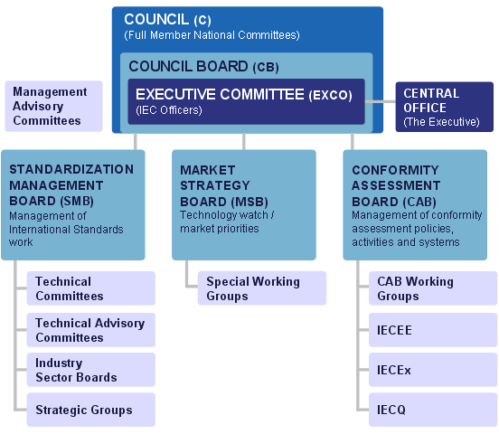
Organization Chart
Organigramme
BRIEF REVIEW

Slide 17
Conclusion
BRIEF REVIEW
Electrotechnology a growing part of world trade, underpinned by international standards
IEC standards and services offer
  market access
  global awareness
  technology transfer
  business efficiency
Participation means real benefits

Slide 18
Contents
BRIEF REVIEW
DASC & IEC AGREEMENTS

Slide 19
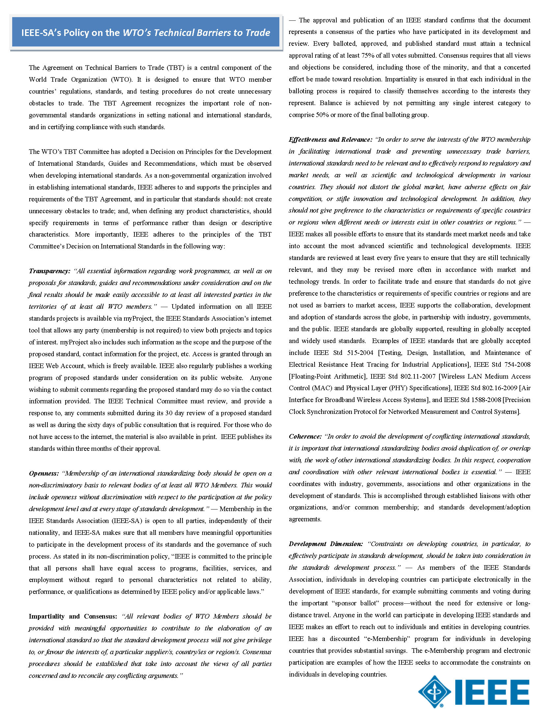
IEEE & IEC
IEC recognized by WTO
IEEE-SA’s Policy on the WTO’s Technical Barriers to Trade similar to IEC
  Transparency
  Openness
  Impartiality and Consensus
  Effectiveness and Relevance
  Coherence
  Development Dimension

Slide 20
IEEE, DASC & IEC: Dual Logo
In early 1990’s Dual Logo was encouraged by
  DASC’s IEC Liaison
    At first: Synchronized IEEE and IEC ballots
    Offered: IEC “fast track” and other mechanisms (like PAS)
    Settled on: IEC-IEEE DUAL LOGO Agreement
  IEEE BOD Standards Representative (pre-IEEE SA)
    Worked hard to complete dual logo agreement
Dual logo aligns mismatch in standards approval
  IEEE
    Technical experts (one expert, one vote)
    Industry collaboration (one entity, one vote)
  IEC
    National body representative (one country, one vote)
Dual logo simplifies “internationalization”

Slide 21
TC 93 Membership
Country | Country Code | P/O Status | IEC Membership
Belgium | BE | O-Member | Full Member
China | CN | P-Member | Full Member
Czech Republic | CZ | O-Member | Full Member
Germany | DE | O-Member | Full Member
Denmark | DK | O-Member | Full Member
Egypt | EG | O-Member | Full Member
Spain | ES | O-Member | Full Member
Finland | FI | O-Member | Full Member
France | FR | O-Member | Full Member
United Kingdom | GB | O-Member | Full Member
Hungary | HU | O-Member | Full Member
Ireland | IE | O-Member | Full Member
India | IN | O-Member | Full Member
Italy | IT | O-Member | Full Member
Japan | JP | P-Member | Full Member
Korea, Republic of | KR | P-Member | Full Member
Netherlands | NL | O-Member | Full Member
Serbia | RS | O-Member | Full Member
Russian Federation | RU | O-Member | Full Member
Sweden | SE | O-Member | Full Member
Singapore | SG | O-Member | Full Member
Ukraine | UA | O-Member | Full Member
United States of America | US | P-Member | Full Member

Slide 22
TC 93 Structure
Role | Name | Term Of Office | NC
Technical Officer | Mr Tim Rotti |  | XC
Chairman | Mr Osamu Karatsu | 2013-09-30 | JP
Secretary | Ms Jodi Haasz |  | US

Slide 23
TC 93 Working Groups
Type | Label | Description | Scope
Joint Working Groups | JWG 11 | Product description standard for printed board, printed board assembly, and testing in XML schema | Joint Working Group 11 is responsible for digital descriptions of completely designed printed boards and printed board assemblies with emphasis on the manufacturing requirements of the final product.
Working Groups | WG 6 | Library of Reusable Parts for Electrotechnical Products | The activity of WG6 is to prepare standards in the area of component libraries to facilitate the interoperability of the semantics of the component information.
Working Groups | WG 7 | Testing of Electrotechnical Products | WG 7 is the system test working group for IEC/TC 93. This group handles the review and recommendation for standards related to test and diagnosis of systems such as the Atlas 716 standard, EDIF for Test, A Broad Based Environment for Test, etc. reports covering issues related to system test standards.
Working Groups | WG 3 | Product Data Exchange (PDX) characteristics and methodology | To develop IEC Standards based on an XML encoding scheme that enables a total product definition to be described at a level appropriate to facilitate supply chain interactions.
Working Groups | WG 1 | Electronical data harmonization (Approaches, methodologies and technologies) | To propose to TC 93 an overall strategy and practical working approach for the harmonization and interoperability of electrotechnical data description standards.
Working Groups | WG 2 | Component, circuit and system description languages | Review of the technical quality of HDL-related draft standards developed by working groups of other standards group, e.g., the Design Automation Standards Sub-Committee of the IEEE
Working Groups | WG 5 | Test, validation, conformance and qualification technologies | To investigate test, validation, conformance and qualification methodologies for international standards for electrical and electronic product data exchange.

Slide 24
TC 93 WG 2 Organization *
Role | Name | NC
Co-Convenor | Mr Satoshi Kojima | JP
Convenor | Mr Dennis B Brophy | US
Member | Mr Ichiro Yamamoto | JP
Member | Mr Ron Waxman | US
Member | Mr Wolfgang Roethig | US
Member | Mr Tsutomu Nakamori | JP
Member | Mr S. Krolikoski | US
Member | Mr Osamu Karatsu | JP
Member | Mr Toshiki Kanamoto | JP
Member | Ms Kumiko Ishiko | JP
Member | Mr Tamio Hoshino | JP
Member | Mr Takashi Hasegawa | JP
Member | Ms Kasumi Hamaguchi | JP
Member | Ms Jodi Haasz | US
Member | Mr Takashi Aikyo | JP
*While efforts have been made to keep the membership information current, the official roster appears stale and requests to correct it have not been fully addressed.

Slide 25
TC 93 Publications
Reference | Edition | Date | Title
IEC 61182-2 | Edition 1.0 | 2006-09-27 | Printed board assembly products - Manufacturing description data and transfer methodology - Part 2: Generic requirements
IEC 61523-1 | Edition 1.0 | 2001-09-17 | Delay and power calculation standards - Part 1: Integrated circuit delay and power calculation systems
IEC 61523-3 | Edition 1.0 | 2004-09-24 | Delay and power calculation standards - Part 3: Standard Delay Format (SDF) for the electronic design process
IEC 61690-1 | Edition 1.0 | 2000-01-31 | Electronic design interchange format (EDIF) - Part 1: Version 3 0 0. (This publication is available in electronic HTML format only)
IEC 61690-2 | Edition 1.0 | 2000-01-31 | Electronic design interchange format (EDIF) - Part 2: Version 4 0 0. (This publication is available in electronic HTML format only)
IEC 61691-1-1 | Edition 2.0 | 2011-05-19 | Behavioural languages - Part 1-1: VHDL Language Reference Manual
IEC 61691-6 | Edition 1.0 | 2009-12-14 | Behavioural languages - Part 6: VHDL Analog and Mixed-Signal Extensions
IEC 61691-7 | Edition 1.0 | 2009-12-14 | Behavioural languages - Part 7: SystemC R Language Reference Manual
IEC/TR 61908 | Edition 1.0 | 2004-11-24 | The technology roadmap for industry data dictionary structure, utilization and implementation
IEC 61926-1 | Edition 1.0 | 1999-10-18 | Design automation - Part 1: Standard test language for all systems - Common abbreviated test language for all systems (C/ATLAS)
IEC/TR 61926-1-1 | Edition 1.0 | 1999-10-20 | Design automation - Part 1-1: Harmonization of ATLAS test languages
IEC 62014-1 | Edition 1.0 | 2001-05-18 | Electronic design automation libraries - Part 1: Input/output buffer information specifications (IBIS version 3.2)
IEC/TR 62014-3 | Edition 1.0 | 2002-12-04 | Electronic design automation libraries - Part 3: Models of integrated circuits for EMI behavioural simulation
IEC 62016 | Edition 1.0 | 2003-12-18 | Core model of the electronics domain
IEC 62243 | Edition 1.0 | 2005-07-07 | Artificial intelligence exchange and service tie to all test environments (Al-ESTATE)
IEC 62525 | Edition 1.0 | 2007-11-07 | Standard Test Interface Language (STIL) for Digital Test Vector Data
IEC 62526 | Edition 1.0 | 2007-11-07 | Standard for Extensions to Standard Test Interface Language (STIL) for Semiconductor Design Environments
IEC 62527 | Edition 1.0 | 2007-11-07 | Standard for Extensions to Standard Test Interface Language (STIL) for DC Level Specification
IEC 62528 | Edition 1.0 | 2007-11-07 | Standard Testability Method for Embedded Core-based Integrated Circuits
IEC 62529 | Edition 1.0 | 2007-11-07 | Standard for Signal and Test Definition
IEC 62530 | Edition 2.0 | 2011-05-19 | SystemVerilog - Unified Hardware Design, Specification, and Verification Language
IEC 62531 | Edition 1.0 | 2007-11-07 | Standard for Property Specification Language (PSL)

Slide 26
More Information
Next meeting: 5-7 September 2011, Seoul, KR
Website
  IEC: www.iec.ch
  TC 93: http://www.iec.ch/dyn/www/f?p=103:7:0::::FSP_ORG_ID,FSP_LANG_ID:1288,25

Slide 27
Thank you for your attention.
Any questions?

